Slide 1
Introduction to Fusion Power
Steve Cowley, Princeton

Slide 2
Building a Nucleus
Repulsion of
Positive charges
Strong force
Binding energy per nucleon of a nucleus with
N_{p} protons and N_{n} neutrons.

Slide 3
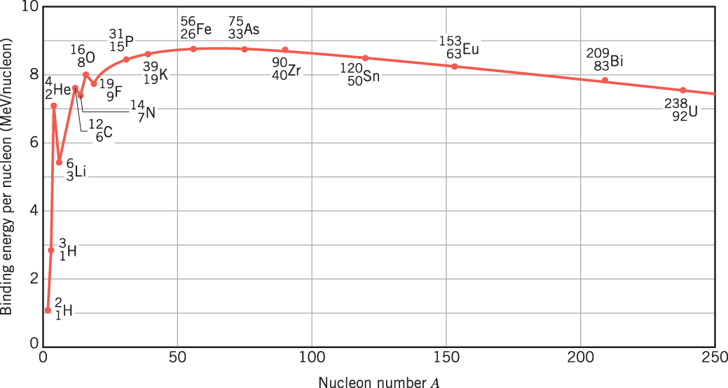
Nuclear binding Energy
Number of protons plus neutrons

Slide 4
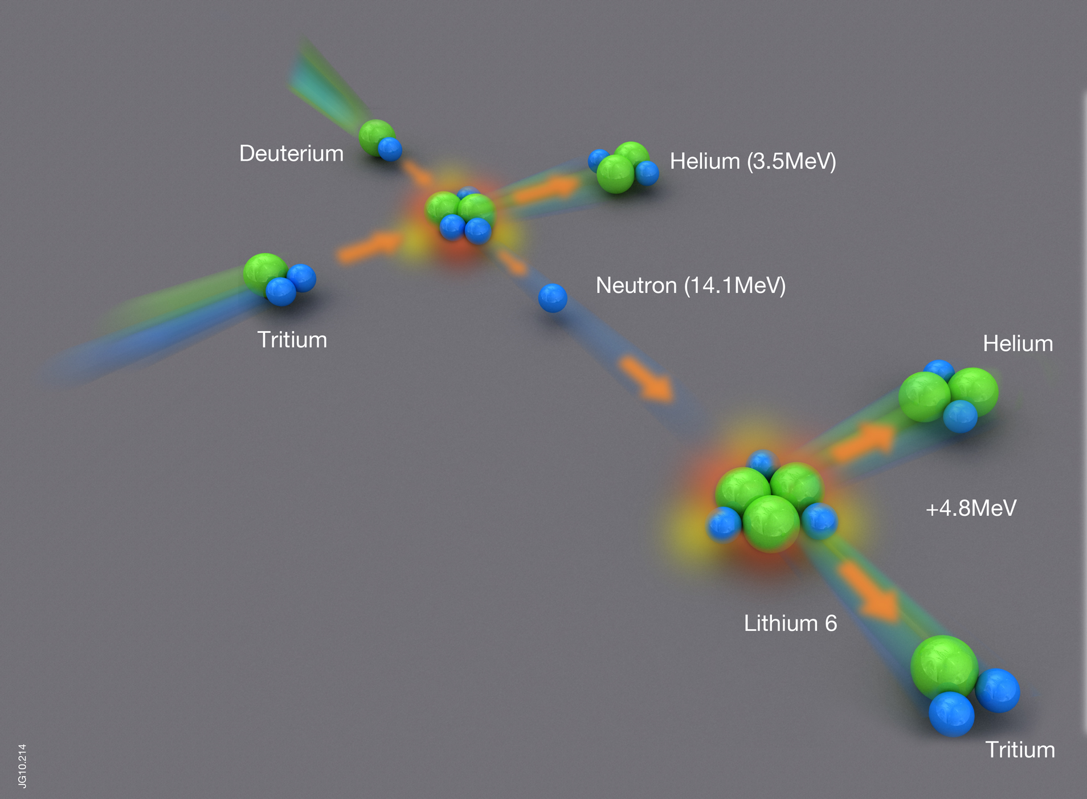
Power density = 0.1(Pressure in atmospheres)² (MWm⁻³)
Plasma at 200 million degrees C
Blanket at ~ 600 degrees C
Enough lithium in seawater to supply 30 million years of world energy needs

Slide 5
Reaction Rate
Deuterium Tritium reaction
Deuterium Deuterium
Simple calculation yields
The power generated in
Each cubic meter.
Approximately
100 million degrees C
Plasma pressure in atmospheres

Slide 6
Magnetic Confinement?

Slide 7
Motion of Particle in a Magnetic Field
Force on Particle in a Magnetic Field
Makes a circle around field line.
Motion along field unimpeded.

Slide 8
Motion of Particle in a Magnetic Field

Slide 9
Magnetic fusion – making a bottle

Slide 10
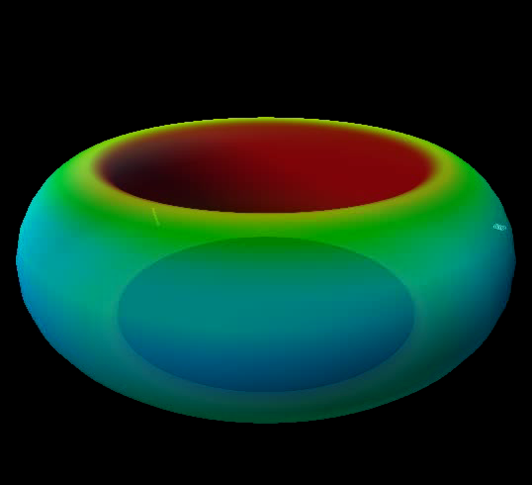

Slide 11
Princeton First -- TFTR

Slide 12
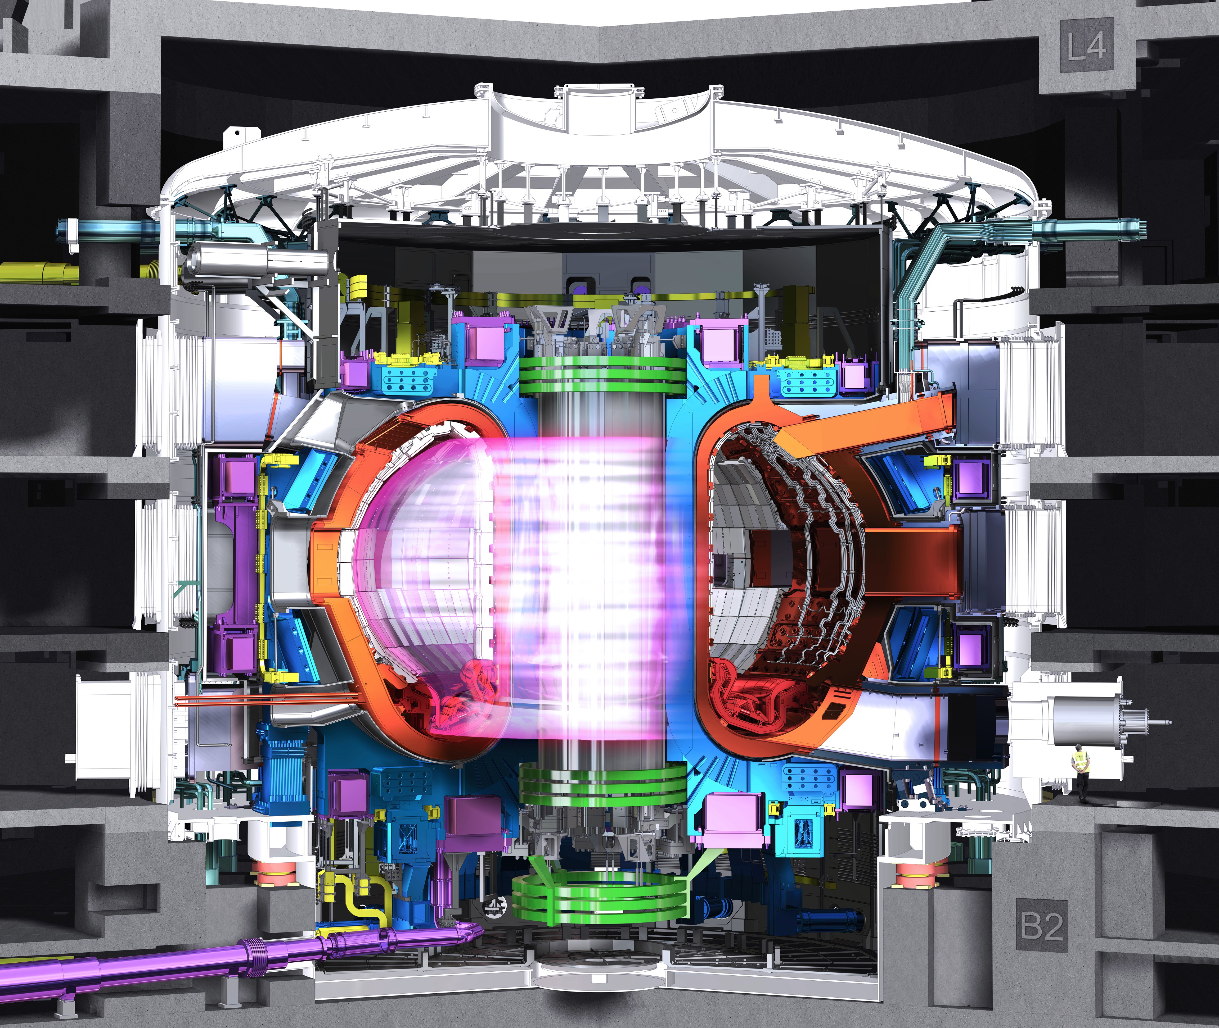







ITER
First sustained burning plasma
Starts in 2025
BASIC PARAMETERS:
Fusion Power 500MW
Burn Flat Top > 400 seconds
Power Amplification Q>10
Cost is > 12 Billion Euro

Slide 13
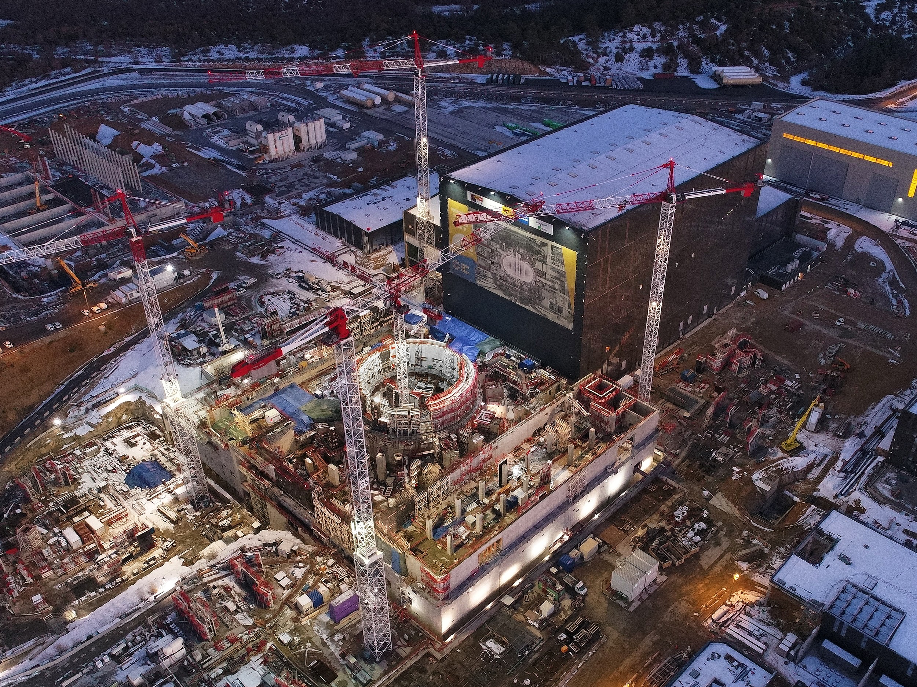

Slide 14
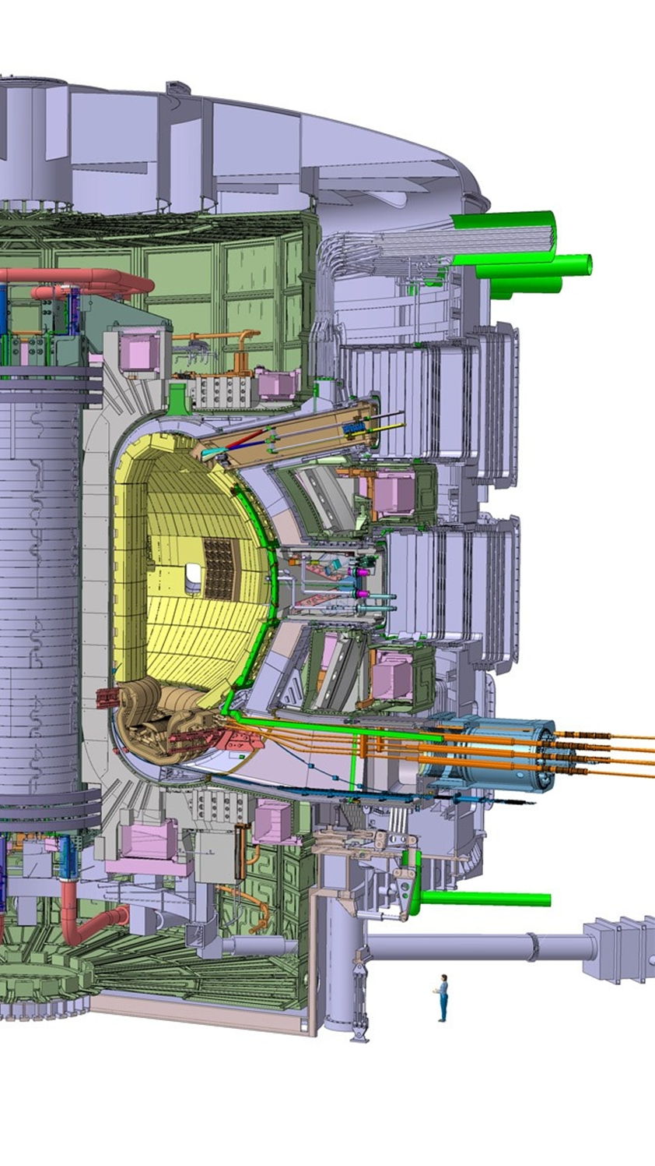
Fusion energy balance in ITER
‘Baseline Performance’
Power in alphas captured by
Plasma P_{α} ~ 100MW.
Power in neutrons escaping
Plasma P_{n} ~ 400MW.
P_{n} + P_{α} = P_{Fusion}
P_{α}
P_{n}
3.5MeV
14MeV

Slide 15
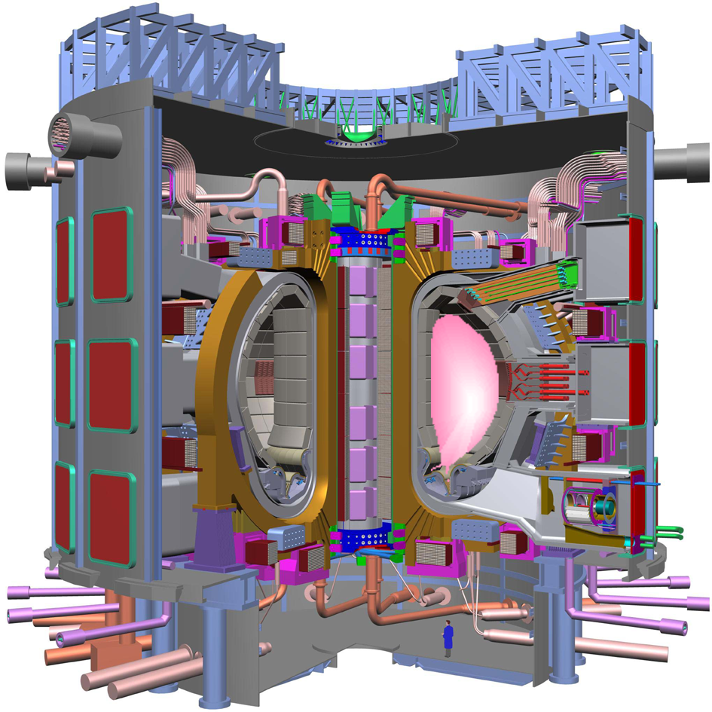
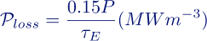
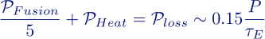
Fusion Energy Balance in ITER
Turbulent Plasma Energy Loss
Confinement Time
External Plasma heating
P_{Heat}~50MW
Energy Balance
Energy Gain = Q > 10

Slide 16
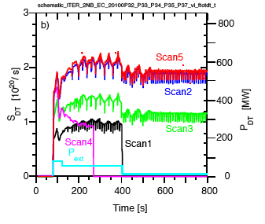
ITER computer modelling
Simulation by Bob Budny:
Simulation by Bob Budny: benchmarked against JET results
Fusion
Power (MW)
Heating
Power (70 MW)
Heating
Power (~0 MW)

Slide 17
Will ITER Burn?

Slide 18
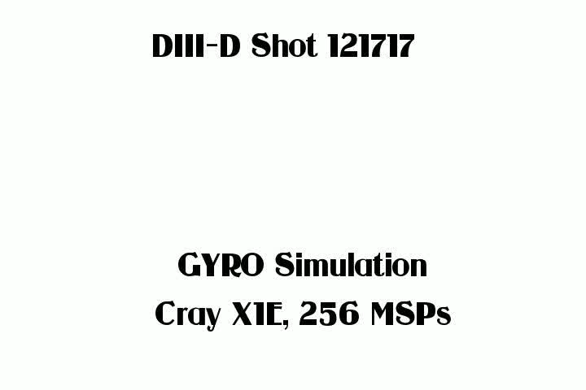

Supercomputing the Plasma

Slide 19
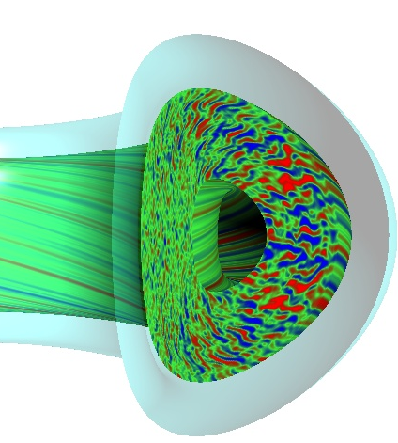
Energy Confinement -- Random walk of heat/particles.
L = typical machine size
= radial eddy size ∝ Ion larmor
radius ρ_{i} = random step.
N = number of steps to
random walk out of plasma
For ITER N ~ 10⁶.

Slide 20
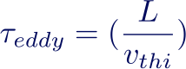
Energy Confinement -- Random walk of heat/particles.
Eddy turnover time =
Dramatic scaling with size!
Scaling approximately agrees with
data BUT geometry dependant.

Slide 21
Simple considerations – things we all know
For plasma at 10-20Kev temperatures (100-200MºC) D-T fusion power density is approximated by:
Plasma pressure in atmospheres
Magnetic pressure = P_{Magnetic} ~ 4 B² (atmospheres)
Figure of merit β = P/P_{Magnetic}
Magnetic Field in Tesla

Slide 22
Simple considerations
The energy confinement time is defined by:
Equating the heating from fusion alphas to the transport/turbulent power lost
LAWSON CRITERION.
P= Central Plasma pressure (atmospheres)
τ_{E} in seconds
or
Magnetic Field in Tesla
HOW DO WE FIND AND EXPRESSION FOR

Slide 23
Engineering Scaling – rule of thumb
Supercomputing and experiments predict GYRO-BOHM LIKE SCALING
Or in engineering parameters ignition requires
PHYSICS
ENGINEERING
For ITER like tokamaks. R is major radius in metres
B is central magnetic field in tesla
SELF SIMILAR SCALING

Slide 24
Smaller Faster Cheaper?
Physics and Engineering Innovation

Slide 25
Cost – Rule of Thumb
Sheffield, Freidberg, Meade etc. Empirical fit to the machines/experiments that have been built
constants
This formula results from the cost of engineering not
the cost of stuff (steel, tungsten, niobium etc.).
SIMPLICITY MATTERS

Slide 26
Getting to Commercial Fusion – innovation
MIT group
Sorbom et. al.
Spherical Tokamak Pilot Plant – less than 1%
of the volume of the EU demonstration reactor
Commonwealth Fusion Systems

Slide 27
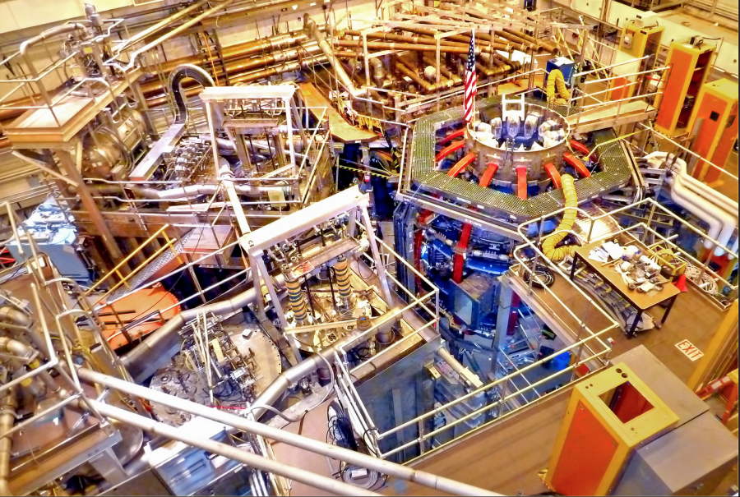
NSTX-U is Crucial
NSTX-U is a platform for discovery
‘Spherical Tokamak’: Does it confine the plasma better?
Can we control it at high pressure (β)?
Can we exhaust he heat from this high power density plasma?
Impact:
Long-lever validation of theoretical models
Evaluate Spherical Tokamak as a compact, less-expensive fusion system

Slide 28
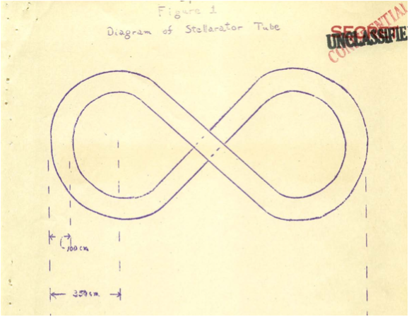
Stellarator – a modern approach
Lyman Spitzer Princeton 1951

Slide 29
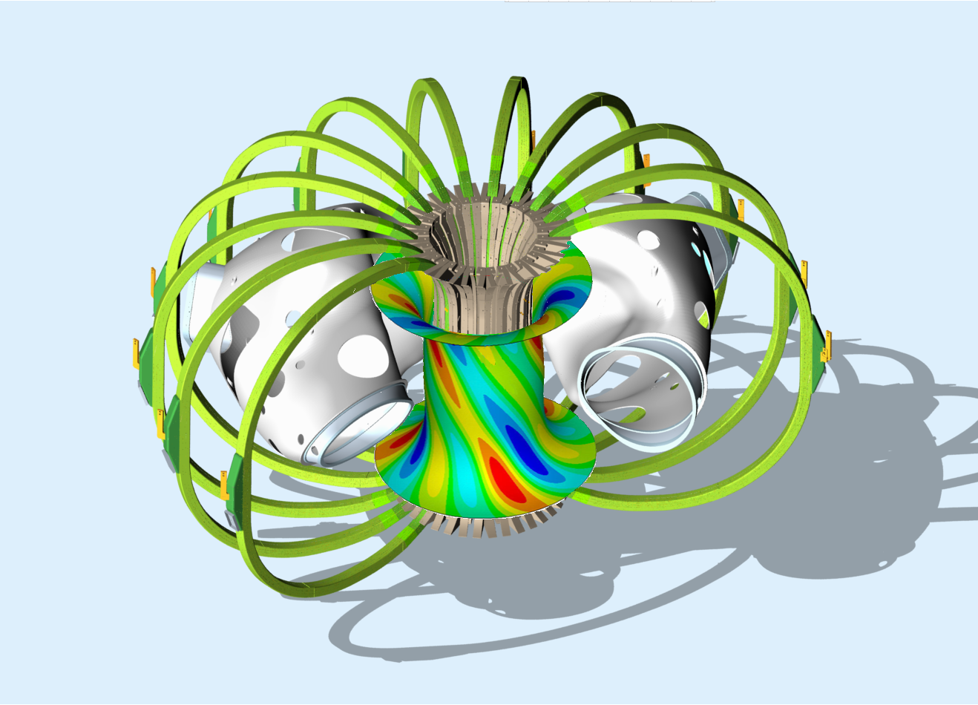
Stellarator – Simplicity – Permanent Magnets
Mike Zarnstorff, David Gates, SC
Simon’s Foundation: Hidden
Symmetries Collaboration
Neodymium Magnets to
make the shaping.
Flexible configuration precise
Fields.
Low B
Use NCSX pieces?
Low cost
Demountable

Slide 30
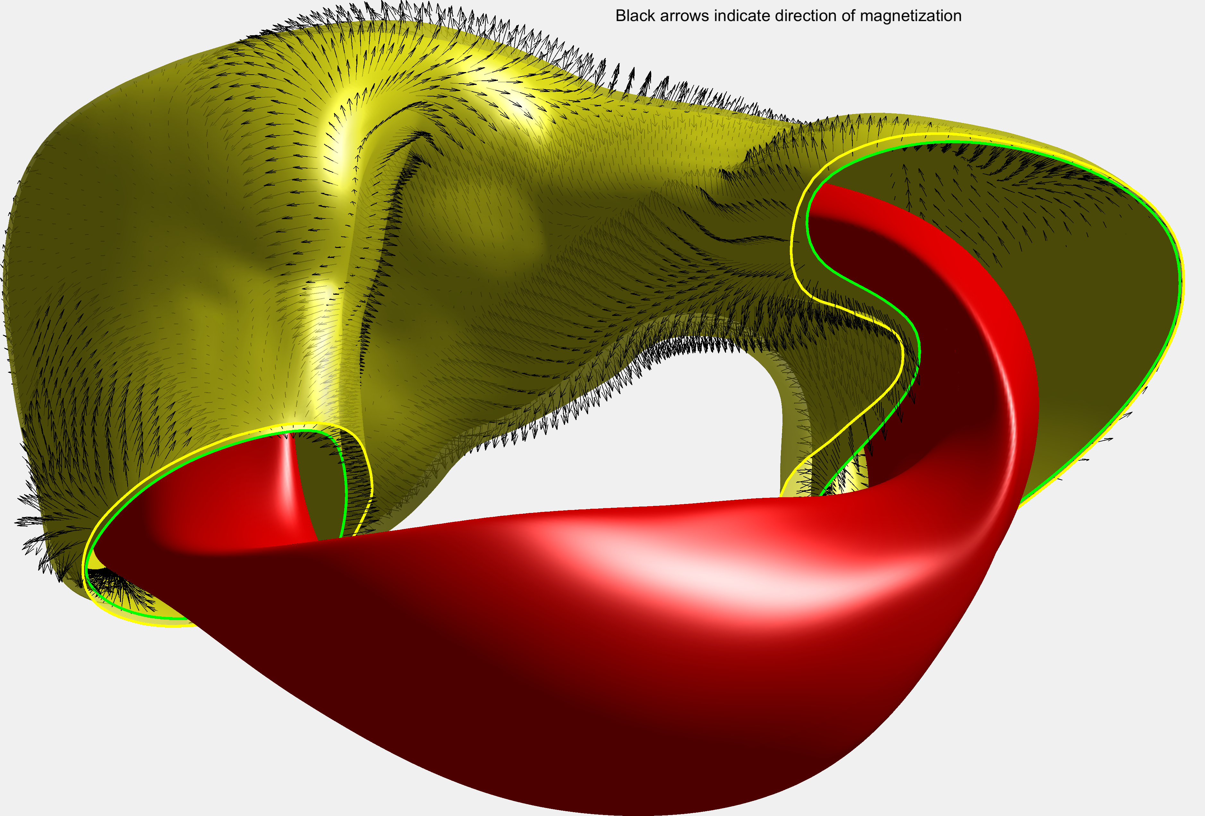
Innovation – permanent magnet stellarator

Slide 31
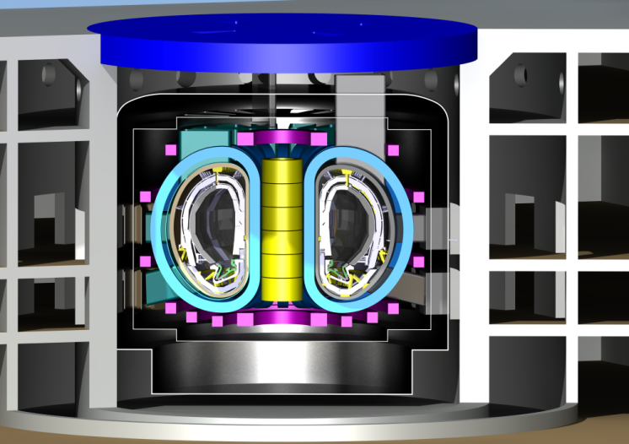
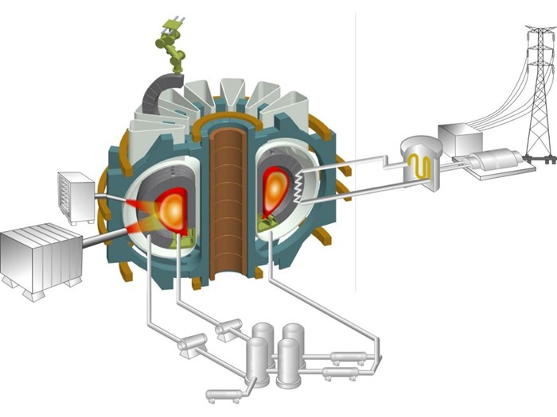
First Electricity Mid-Century
CFETR Chinese Demonstration reactor
design
Korean Demonstration Reactor

Slide 32
Perfect Energy?
Safe, no waste legacy, abundant, minimal land use. But……
Development is not optional
We must push down the cost and scale if we are to get to market.

